Slide 1

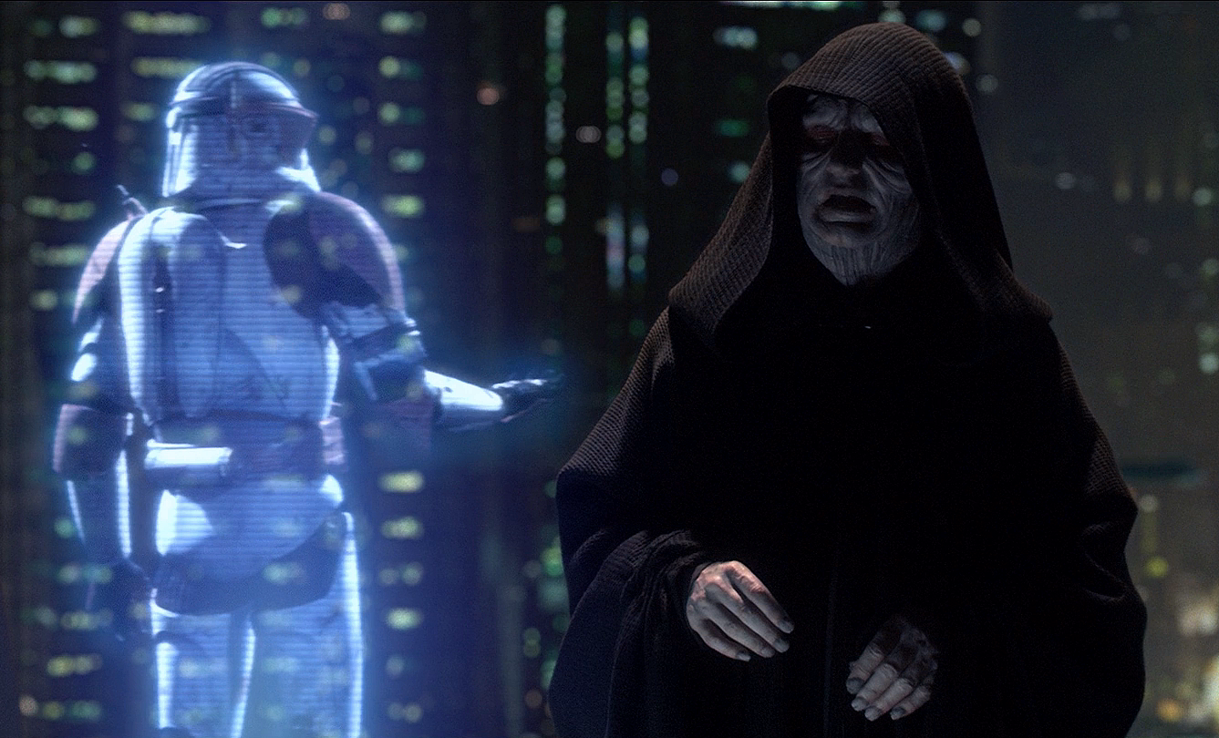
Holography
An emerging technology
September, 25th
Semester 1
Arthur MURILLO
Xabi AVELLAN
Sofian EON

Slide 2
HOLOGRAPHY : PLAN
Background : When did it appear?
Present day : What does it look like?
Future : How could it look like? What could it become?
Conclusion

Slide 3
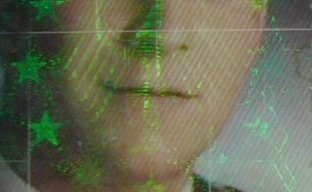
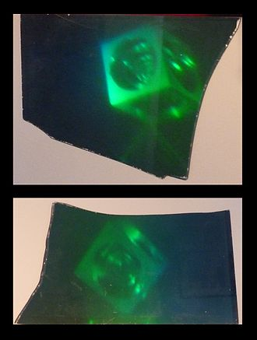
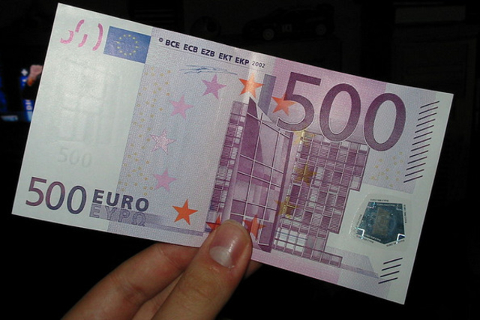
HOLOGRAPHY : BACKGROUND

Slide 4
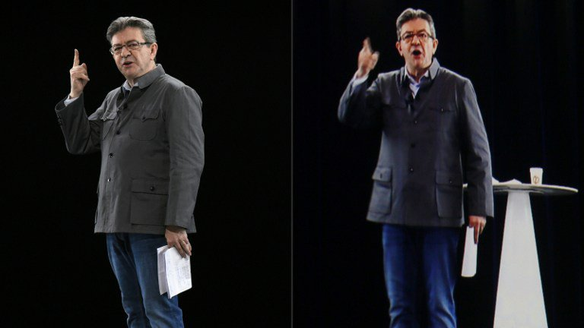
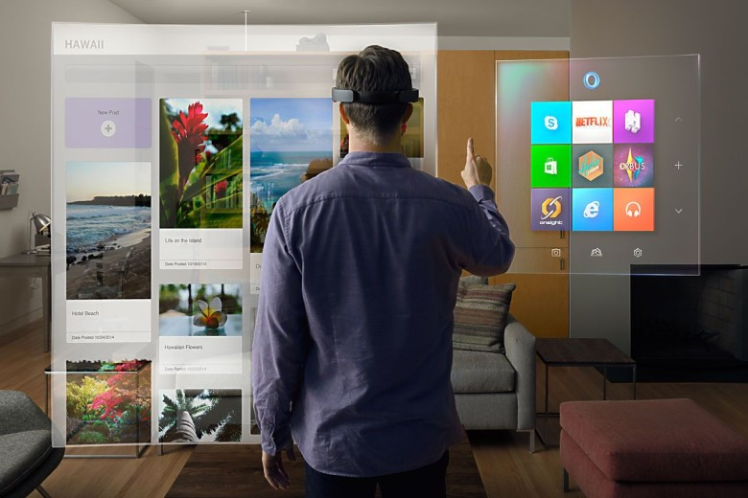
HOLOGRAPHY : PRESENT DAY

Slide 5
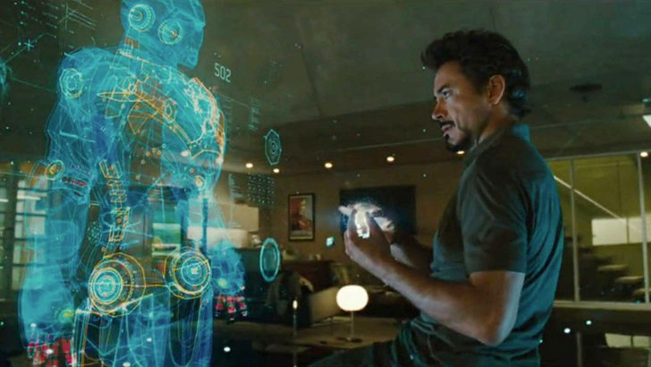
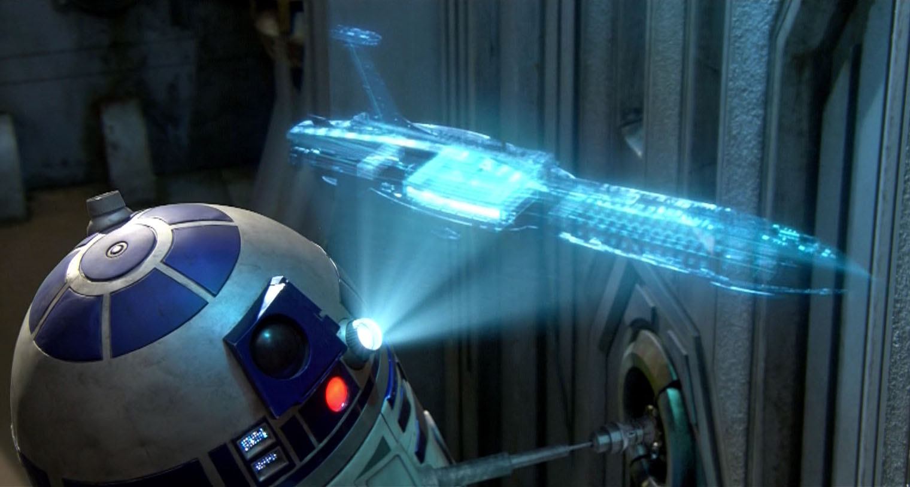
HOLOGRAPHY : FUTURE

Slide 6
HOLOGRAPHY : CONCLUSION

